Slide 1


Computational Intelligence (TC2027)

Slide 2
Unit 4 – Network Security (III)
Using Snort IDS

Slide 3

Snort IDS
Snort is the foremost open-source Intrusion Prevention System (IPS) in the world.
Snort IPS uses a series of rules that help define malicious network activity and uses those rules to find packets that match against them and generates alerts for users.

Slide 4
Snort Applications
packet sniffer like tcpdump
packet logger — which is useful for network traffic debugging
full-blown network intrusion prevention system.

Slide 5
Basic Config
The main config file is: /etc/snort/snort.conf
To start to use the IDS is required to change the variable $HOME_NET, setting your home net address (ex.: 10.0.0.02/24).

Slide 6
Testing Snort Installation
# snort -d -l /var/log/snort/ -h 10.0.0.0/24 -A console -c /etc/snort/snort.conf
d= tells snort to show data
l= determines the logs directory
h= specifies the network to monitor
A= instructs snort to print alerts in the console
c= specifies Snort the configuration file

Slide 7
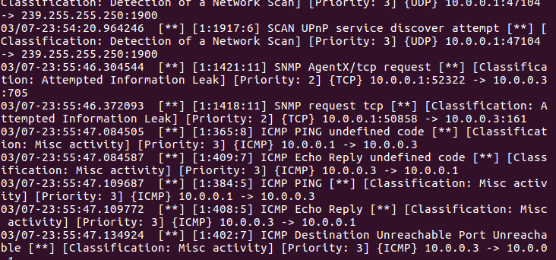
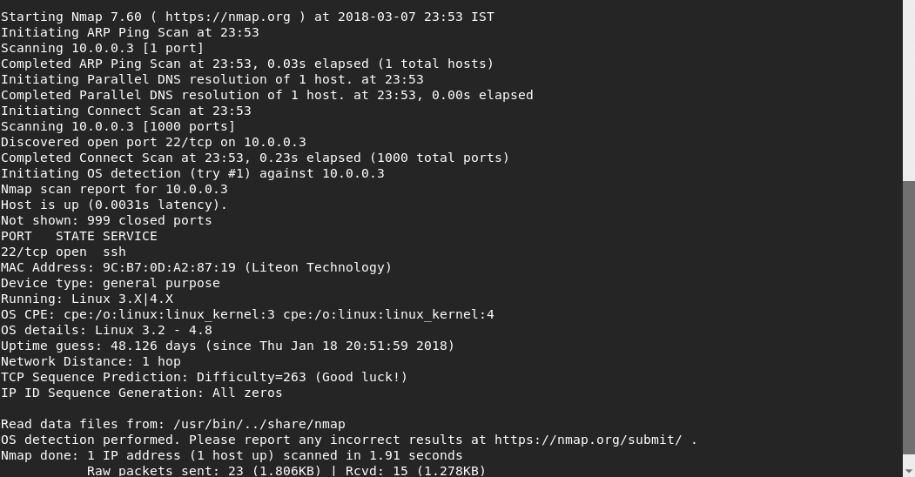
Testing Snort Installation
-v verbose
-sT scan only ports TCP (-sU UDP)
-O identify operational system
#nmap –v –sT –O 10.0.0.40

Slide 8
Testing Snort Installation
-v verbose
-sT scan only ports TCP (-sU UDP)
-O identify operational system
#nmap –v –sT –O 10.0.0.40

Slide 9
Testing Snort Installation
-v verbose
-sT scan only ports TCP (-sU UDP)
-O identify operational system
#nmap –v –sT –O 10.0.0.40

Slide 10
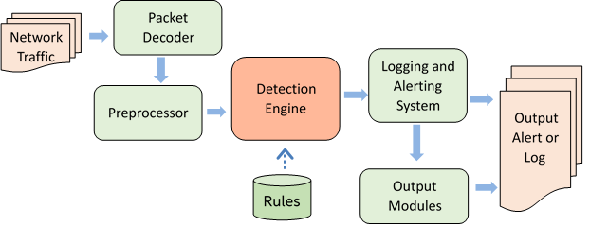
How Snort works?

Slide 11
Snort Decoder
The decoder has the job of determining which underlying protocols are used in the packet (such as Ethernet, IP, TCP, etc.) and saves this data along with the location of the payload/application data in the packet (which it doesn’t try to decode) and the size of this payload for use by the preprocessor and detection engines.

Slide 12
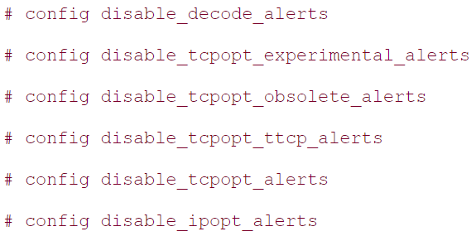
Configuring Decoder
The configuration is in the snort.conf.
Notes:
https://www.informit.com/articles/article.aspx?p=101148&seqNum=3

Slide 13
Snort Preprocessor
Examine packets for suspicious activity: Several attacks cannot be detected by signature matching via the detection engine, so "examine" preprocessors step up to the plate and detect suspicious activity. These types of preprocessors are indispensable in discovering non-signature-based attacks.
Notes:
https://www.informit.com/articles/article.aspx?p=101148&seqNum=3

Slide 14
Snort Preprocessor
Modify packets so that the detection engine can properly interpret them: The other preprocessors are responsible for normalizing traffic so that the detection engine can accurately match signatures. These preprocessors defeat attacks that attempt to evade Snort's detection engine by manipulating traffic patterns.
Notes:
https://www.informit.com/articles/article.aspx?p=101148&seqNum=3

Slide 15
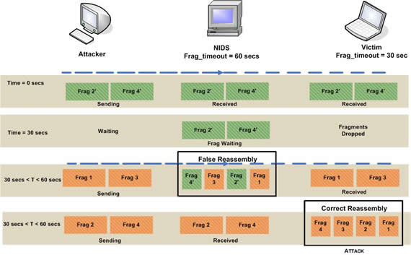
Preprocessor frag2
The frag2 preprocessor is Snort's weapon against IP fragmentation attacks.

Slide 16
Preprocessor stream4
The stream4 preprocessor is what Snort uses to maintain the state of TCP streams, which is used in detecting some types of information gathering attacks.
Stateful inspection with stream4 helps Snort better match attack signatures across multiple packets.
This is important because attacks can be spread over many individual packets or exhibit anomalies in terms of TCP connections.
The stream4 preprocessor also lets you create rules that are state-aware via the flow option.

Slide 17
Preprocessor stream4_reassemble
It performs TCP stream reassembly to stream4.
Malformed packet injection is one of the many reassembly attacks.
Malicious hackers attack the TCP stream reassembly process by creating packets with some valid header data such as sequence numbers, ACK numbers, source ports, and destination ports.
The forged packets have a bogus payload and a checksum that fails.
These crafted packets are inserted between totally valid packets.

Slide 18
Preprocessor HTTP_decode
The HTTP_decode preprocessor is responsible for detecting abnormal HTTP traffic and normalizing it so that the detection engine can properly interpret it.
Normalizing traffic: process of translating an obscure character set, such as Unicode or hex, to a character set that Snort can recognize.
It generates an alert if it encounters traffic that requires decoding.

Slide 19
Preprocessor RPC_decode
This preprocessor has a similar function as HTTP_decode, but with another protocol: RPC.
RPC can be used for both reconnaissance and remote exploit attacks.
Attackers can use port mapping applications, such as rpcbind and portmapper, that make dynamic binding of remote services possible.
The attacker can use information gathered from rpcbind to find additional targets for buffer overflows, or the attacker can attack the RPC service itself.

Slide 20
Preprocessor BO
The BO preprocessor detects Back Orifice.
Back Orifice: remote control Trojan for Windows systems.
Back Orifice was a very popular Trojan when it was released but has recently been replaced by other more advanced Trojans.
Back Orifice remains a considerable threat; it can be used by script kiddies to take total control of a remote system.

Slide 21
Preprocessor ASN1_decode*
ASN1_decode is a preprocessor designed to detect various inconsistencies in ASN.1 that may indicate malicious behavior.
ASN.1: is an international standard for coding and transmitting complex data structures (LDAP, SNMP, SSL, and X.509, other proprietary government communication and industrial applications).
Portions of the U.S. power grid are controlled remotely by the ASN.1 protocol.
The SS7 network that controls telephone call routing, parcel delivery, and credit card verification systems all use ASN.1.
* Abstract Syntax Notation One

Slide 22
Preprocessor fnord
The fnord preprocessor is designed to detect and defeat polymorphic shell code evasion attempts.
Polymorphic shell code and Polymorphic viruses change their signature randomly to avoid detection by static signature-based Antivirus applications.
An example of this approach to remote exploit shell code was developed recently to evade IDSs and released with the ADMutate tool.

Slide 23
Preprocessor conversation
The conversation preprocessor is similar to the stream4 and stream4_reassemble preprocessors; however, to tracks pseudo-sessions or conversations for any other IP protocol (such as ICMP).
This is useful for detecting where communication has originated. It can also detect when new communication commences.
The conversation preprocessor must be enabled for the portscan2 preprocessor to function.

Slide 24
Preprocessor portscan2
It is the anomaly detection portscan preprocessor.
Portscan detected reconnaissance attempts by alerting whenever packets were seen going to four different ports in less than three seconds. This set off a lot of false positives.
Even though you could specify which IP addresses to ignore, a fair amount of Snort regulars would disable the preprocessor altogether.

Slide 25
Preprocessor SPADE
SPADE (Statistical Packet Anomaly Detection Engine) is a preprocessor that detects suspicious traffic via anomaly detection methods.
SPADE determines whether traffic is anomalous by building a table to describe normal traffic patterns.
When traffic does not match data stored in the table, SPADE outputs an alert.

Slide 26
Preprocessor Configuration
The configuration is done in snort.conf.

Slide 27
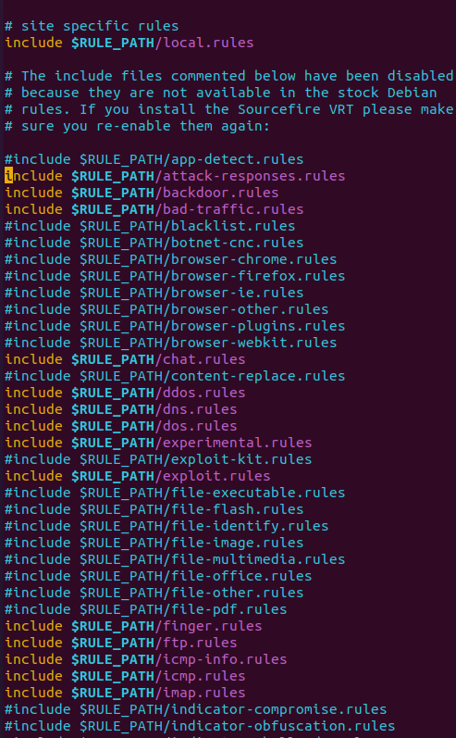
Snort Rules
Snort’s NIDS mode works based on rules specified in the /etc/snort/snort.conf file.

Slide 28

Understanding Snort Rules
There are several rules to prevent backdoor attacks, surprisingly there is a rule against NetBus, a trojan horse which became popular a couple of decades ago.

Slide 29
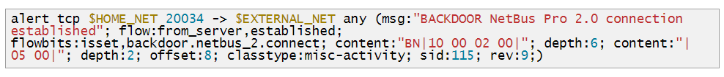
Understanding Snort Rules
-> = specifies the traffic direction, in this case from our protected network to an external one
msg = instructs the alert to include a specific message when displaying
content = search for specific content within the packet. It can include text if between “ “ or binary data if between | | depth = Analysis intensity, in the rule above we see two different parameters for two different contents offset = tells Snort the starting byte of each packet to start searching for the content classtype = tells what kind of attack Snort is alerting about
sid:115 = rule identifier

Slide 30
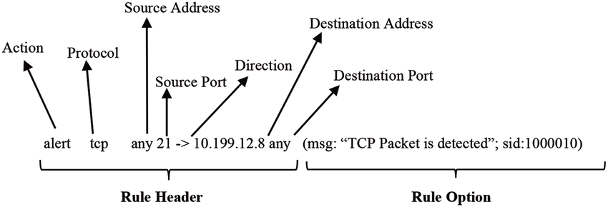
Snort Rule Format (Rule Header)
Action Rules:
Alert: It generates an alert using alert method.
Log: After generating alert, it then logs the packet.
Pass : It ignores the packet and drops it.
Drop: block and log the packet.
Reject: block the packet, log it, and then send a TCP reset if the protocol is TCP or an ICMP port unreachable message if the protocol is UDP.
Sdrop: block the packet but do not log it.

Slide 31
Snort Rule Format (Rule Header)
Protocol: IP, TCP, UDP, ICMP, any.
Source IP / Source Port
Direction operator: ->, <>
Destination IP / Destination Port

Slide 32
Snort Rule Format (Rule Option)
Rule options form the heart of Snort's intrusion detection engine.
All rule options are separated from each other using the semicolon (;) character.
Rule option keywords are separated from their arguments with a colon (:) character.

Slide 33
Snort Rule Format (Rule Option)
Categories of rule options:
General: These options provide information about the rule but do not have any affect during detection
Payload: These options all look for data inside the packet payload and can be inter-related
non-payload: These options look for non-payload data
post-detection: These options are rule specific triggers that happen after a rule has “fired.”

Slide 34
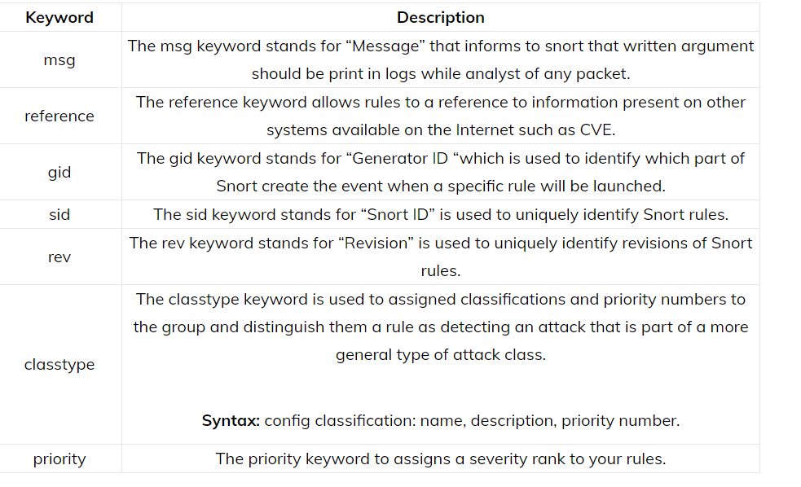
Snort Rule Format (Rule Option)

Slide 35
Snort Rule Format (Rule Option)

Slide 36
Writing a Snort Rules
Create the file /etc/snort/rules/yourrule.rules
The rule set the Snort to alert about any tcp connection from any external source to our SSH port (in this case the default port) including the text message “SSH INCOMING”, where stateless instructs Snort to ignore the connection’s state.
Add the rule we created to our /etc/snort/snort.conf file.
include $RULE_PATH/yourrule.rules

Slide 37
Computational Intelligence (TC2027)

